Slide 1
Domain #11 Capstone Project TWITTER SENTIMENT ANALYSIS
Group 33
Aditya Baskaran 2019AIML028
Aravind V 2019AIML127
Ganesh Sharma 2019AIML014
Nithesh Balakrishnan 2019AIML049
Vibha Kumar 2019AIML153

Slide 2
Table of Contents
Problem statement
Objective
Business Benefits
Machine Learning Process Flow
Detailed Plan of Work
Pre-processing – Data cleaning
Pre-Processing – Processing Tweet Data
Machine Learning Modelling
Metrics and Interpretation
Conclusion
Future work and extension

Slide 3
Problem Statement
Twitter allows businesses to reach a broad audience and connect with customers without intermediaries. On the downside, there’s so much information that it’s hard for brands to quickly detect negative social mentions that could harm their business.
Listening to customers on Twitter allows companies to understand their audience, keep on top of what’s being said about their brand, and their competitors, and discover new trends in the industry.
The sentiment analysis of twitter can also be applied to analyze the political views of the people which would help in decision of the voting of the political party.
According to a study* Twitter has about 330 million monthly users
* https://en.wikipedia.org/wiki/Twitter

Slide 4
Objective
Background
Sentiment analysis is the automated process of identifying and classifying subjective information in text data.
Since sentiment analysis tools are able to sort Twitter data automatically 24/7, quickly and accurately, you can gain up-to-the-minute insights from your social mentions.
Performing Twitter sentiment analysis can help you quickly understand the tone and context of those social mentions.
Objective
Twitter sentiment analysis allows you to listen to the customers and understand what they need. By introducing sentiment analysis tools into your workflows, you can automatically organize unstructured information (which includes Twitter data) in real-time, at scale, and accurately:

Slide 5
Business Benefits
Business: In marketing field companies use it to develop their strategies, to understand customers’ feelings towards products or brand, how people respond to their campaigns or product launches and why consumers don’t buy some products.
Politics: In political field, it is used to keep track of political view, to detect consistency and inconsistency between statements and actions at the government level. It can be used to predict election results as well!
Public Actions: Sentiment analysis also is used to monitor and analyse social phenomena, for the spotting of potentially dangerous situations and determining the general mood of the blogosphere.

Slide 6

Understanding of Machine Learning( Pipeline)
Extracting Knowledge hidden in large volumes of data
Identifying potentially useful and understandable data - Which data set will give hidden pattern
KDD – Knowledge Discovery in Database/Dataset
Target
Connectedness
Wisdom
Prescriptive
Analysis
What Should be done
KDD Analysis
Understanding
Principles
Knowledge
KDD & Data Mining Analysis
Predictive
Analysis
What could happen
Understanding
Pattern
Information
KDD Analysis
Descriptive
Analysis
What has happened
Understanding
Relations
Data
Understanding

Slide 7
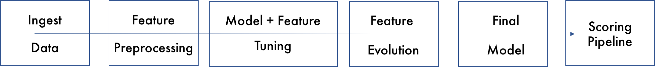
ML Steps
ML Steps
Apply Model
Monitoring
9
Data Preparation
Model Refresh
Classify Tweets
Business
Objectives
Model
Deployment
Drive Initiative
1
8
ML Objectives
7
Build Model
2
Build Model
Calculate Score
3
Data Availability
Validate Model
Data
Modeling
6
4
Data Cleansing
5
Data Transformation

Slide 8
Detailed Plan of work
Problem statement and Business Benefit – detailed discussion
Understanding columns and rows of given input transaction data
Some basic Analysis of given input data using excel pivot
Review and clarification of questions Python and Jupiter notebook installation and environment setup
Incorporation - Feedback and suggestions of last review
Compute sentiment scores (polarity) and labels
Sentiment statistics per news category
Mege positive,negative ,neutral_correctness
Filter out weak score
Label id distribution
Conversion of label to numeric
Explore country wise data and negative tweet
Explore wordcloud of each class
Deep Learning
Using Keras tokenizer
Train using LSTM model
Evaluate the model
Week 01
Week 03
Week 07
Week 05
Week 02
Week 04
Week 06
Week 08
Data Cleaning and Pre-Processing
Read base data excel,label column creation
Check duplicate rows, missing values
Drop irrelevant columns, rows
Processing tweet text data
Removing ‘@’,numbers, urls, single and special characters
Tokenizing
Lemmatization
Stemming
Vectorization using TF-IDF
Supervised Learning
Use LogisticRegression, Gradient Boosting, Random Forest, KNeighborsClassifier, SVM
Understand model accuracy
Evaluate best model
Review and discussion
Final project preperation
Documentation of the project
Conclusion
Adddind derived feature
Tweet source distribution

Slide 9
Project Resources
Sr No | Phase | Resource Type | Resource | Versions if Applicable
1 | All | People | Mentor, Faculty, TA
2 | All | Hardware | Runtime on Google Colab Google Drive
3 | All | Software | Jupyter Notebook Anaconda Python | python:3.6.9 [GCC 8.4.0] scipy:1.4.1 numpy:1.18.4 pandas:1.0.3 re:2.2.1 nltk:3.5
4 | Collaboration | Software | Google Meet GitHub
5 | All | Laptops | 16GB RAM, Windows 10, Intel Core i7

Slide 10
Preprocessing: Data Cleaning and pre-processing
Read base data excel – this data has no Label (class)
Label column creation
Check duplicate rows , check columns having constant value
Check missing values in each column and imputation if required.
Delete rows which are nor relevant
Drop columns which are nor relevant
Add derived features
Tweet_source distribution
Label id distribution
Convert label to numeric
Explore Negative tweet and its category
Country wise positive, Negative and Neutral
WordCloud of each positive, negative and neutral class
Save first round cleaned data

Slide 11
Preprocessing: Processing tweet text data
Removing user handles starting with @
Removing numbers and special characters
Removing urls
Removing single characters
Tokenizing
Removing stopwords
Expanding not words
Lemmatizing the words
Stemming the words
WordCloud of each positive, negative and neutral class with clean tweet
Vectorization using TF-IDF - Term frequency and Inverse Document frequency
Using TextBlob for sentiment analysis polarity detection

Slide 12
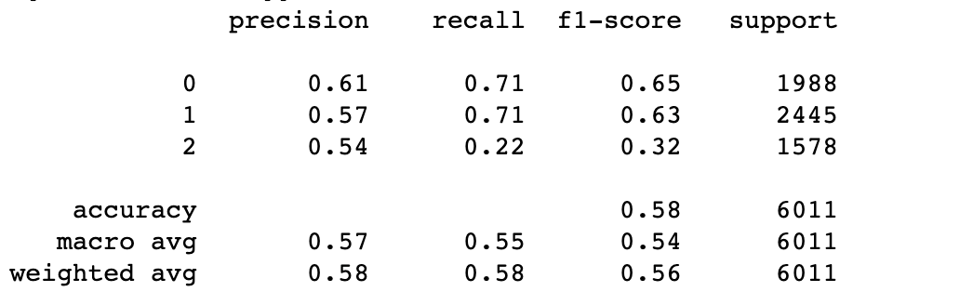
Verify preprocessing accuracy using RF
Preparation
Columns required for Text Processing
Setting the class column as the category for classification
Setting the features and labels array from the data frame
Vectorization using TF-IDF - Converting the Text to numbers
Apply Models
Random Forest
Find Model Summary
Sample Results with Random Forest

Slide 13
Machine Learning Modelling & Techniques Applied
Preparation
Used Textblob for polarity detection
Cleaned the Tweet data
Apply Models
Random Forest Classifier
Gradient Boosting Classifier
Support Vector Machine
Logistic Regression
KNeighbours Classifier
LSTM
Find Model Summary
Sample Results for Binary Classes

Slide 14
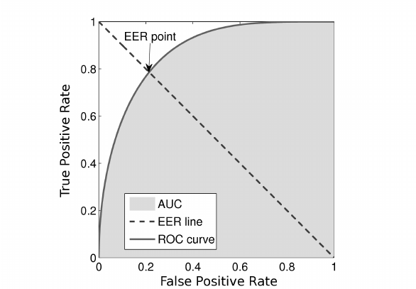
Metrics
Metrics Used to Evaluate
Confusion Matrix | Predicted Denied (Positive – Label: 1) | Predicted Accepted (Negative – Label: 0)
Actual Denied (Positive - Label: 1) | TP | FN
Actual Accepted (Positive - Label: 0) | FP | TN
Recall on 1 (denied) of 0.8 implies that there is 20% chance that a sentiment analysis actually negative may be predicted as positive
Precision on 1(denied) of 0.8 implies that there is 20% chance that a sentiment analysis actually positive may be predicted as negative.
So we chose F1 as the evaluation metrics
We also calculated Equal Error Rate as one of the metric
The idea of ROC EER is the intersection point between a straight line joining (1,0) and (0,1) and the roc Curve.

Slide 15
Interpretation
Based on the metrics, following is the interpretation.
Eliminate the Gradient Boosting and KNN algorithms as it has low F1 score and accuracy.
Random Forest and LSTM are eliminated as it is more suited for multi-class text classification problems.
Logistic Regression and SVM can be considered for this type of sentiment analysis dataset as it gives comparable scores interms of the metrics such as F1 score and accuracy.
SVM works well with unstructured and semi-structured data like text and images while logistic regression works with already identified independent variables.
The risk of overfitting is less in SVM, while Logistic regression is vulnerable to overfitting.

Slide 16
Conclusions / Recommendations
This project was successfully able to classify tweets as ‘positive’, ‘negative’ and ‘neutral’ at the highest possible accuracy by applying multiple suitable models.
F1 score was chosen as the best metric to obtain the accuracy of the model in line with the objective of selecting the best model because it allows us to minimize both false negative and false positive predictions while making true predictions.
It is also comparable to the accuracy score whose trends align with the same.
The use of the NLTK Polarity model also allows each tweet to be allocated a Polarity score which can be used as an identity metric.
Among the models used, although it does not show the highest accuracy for all classes, SVM can be considered the best model to apply for a tweet-based dataset because it is suited for sentiment analysis.
The model effectively classifies tweets on a spectrum from positive to negative, which has great potential in a business environment where social media perception is rapidly affecting the nature of marketing and sales of any and all product available in the market today.

Slide 17
Future Work & Extension or Scope of improvements
A fixed reference data set has been applied to all models, real-time data streaming could be used in the future in order to ascertain immediate polarity of a trend;
Hyper-parameter tuning can be undertaken to improve accuracy of the models with EDA allowing the selection of particular parameters.
An API can be produced in such a way that an end-user can make use of the model to understand the nature of polarity of the Twitter trends with respect to their particular product.
The scope of the project can be further attuned as per client-specific ideas.
More domain knowledge can be brought into the project with methods to improve feature engineering, or to use more ensemble methods and retraining the models with more historical data to improve accuracy.
Auto-ML models like H2O can also be used to see if the more accurate models can be created.

Slide 18
Thank You!
Lead Instructor Name: Prof. Gautam Gangopadhyay {gautam.g@wilp.bits-pilani.ac.in}
Faculty Name: Prof. Raja Vadhana P
Aditya Baskaran
Aravind V
Ganesh Sharma
Nithesh Balakrishnan
Vibha Kumar

